Slide 1
CSE411: Advanced Database Systems
Dr. Abu Sayed Md. Latiful Hoque
Professor, CSE, BUET
&
Visiting Professor, ECE, NSU
Room SAC 1044B
Contact: mobile 01556346357, email: abu.hoque@northsouth.edu

Slide 2
About Course
Course Summary:
Query Evaluation and Optimization, Concurrency Control and Recovery Management, Database System Architectures, Advanced Data Models: Object-Oriented Model, Object-Relational Model, NO-SQL Model etc., Distributed Database: Transaction and Query Processing, Data Warehouse: Design and Implementation.

Slide 3
Books
Text books:
Database System Concepts 7th Edition
By
Abraham Silberschatz, ‎ Henry F. Korth,‎ S. Sudarshan,
Reference books:
Fundamentals of Database Systems 7th Edition
By
Ramez Elmasri and Shamkant B. Navathe

Slide 4
Course Objectives:
The objectives of this course are to:
  acquire in depth knowledge about Query Evaluation and Optimization, Concurrency Control and Recovery Management,
  get students familiar with Advanced Data Models: Object-OrientedModel, Object-Relational Model, NO-SQL Model etc.,
  earn knowledge about the parallel and distributed database system architectures,
  design object based, object-relational and distributed databases in most optimized manner,
  acquire knowledge about the design and implementation of a data warehouse.

Slide 5
Tentative lecture schedule
Week | Content
Week 1-3 | Storage, Indexing, Query Processing and Optimization
Week 4-6 | Transaction, Concurrency Control and Recovery Management,
Week 7-9 | Database System Architectures, Distributed Database: Transaction and Query Processing
Week10-12 | Advanced Data Models: Object-Oriented Model, Object-Relational Model, NO-SQL Model etc., Big Data and Data Warehouse

Slide 6
Weightage Distribution among Assessment Tools (Tentative)
Assessment Tools | Weightage (%) | Remarks
Attendance | 5
Class Performance | 5
Quizzes /Assignments | 20 | Best 2 out of 3
Midterm | 30
Final Exam | 40
Total | 100

Slide 7
Examinations schedule
Assessment Tools | Date
Attendance
Class Performance | Instant
Quizzes: QUIZ 1 | Week 4
Midterm | Week 6
Quizzes: QUIZ 2 | Week 8
Quizzes: QUIZ 3 | Week 11
Final Exam | As per NSU Schedule
Result | As per NSU academic calendar

Slide 8
Basic towards Advanced DBMS
What you have leant in Basic DBMS?
  Data model - Relational model
  Query Languages
    Relational Algebra
    Relational Calculus
    SQL
  Database Design (ERD)
  Refinement of Database Design (Normalization)

Slide 9
Basic towards Advanced DBMS
What you have leant in Basic DBMS?
  Database Storage Management (?????)
  Indexing (?????)
  Query Processing and Optimization (??????)
  Transaction management (???????)
  Concurrency Control of Transactions (???????)
  Recovery from Failure (????????)
  Distributed Database (??????)
  Data Warehouse (??????)

Slide 10

Basic towards Advanced DBMS
Database Storage
Memory
Access time?
Disk
Access time?
In
Memory
Query Processor
Storage manager
In
Disk

Slide 11
Classification of Physical Storage Media
Can differentiate storage into:
  volatile storage: loses contents when power is switched off
  non-volatile storage:
    Contents persist even when power is switched off.
    Includes secondary (????) and tertiary storage (????), as well as battery-backed up main-memory.
Factors affecting choice of storage media include
  Speed with which data can be accessed
    What database component is related with speed?
  Cost per unit of data
  Reliability
    What is related with reliability?

Slide 12
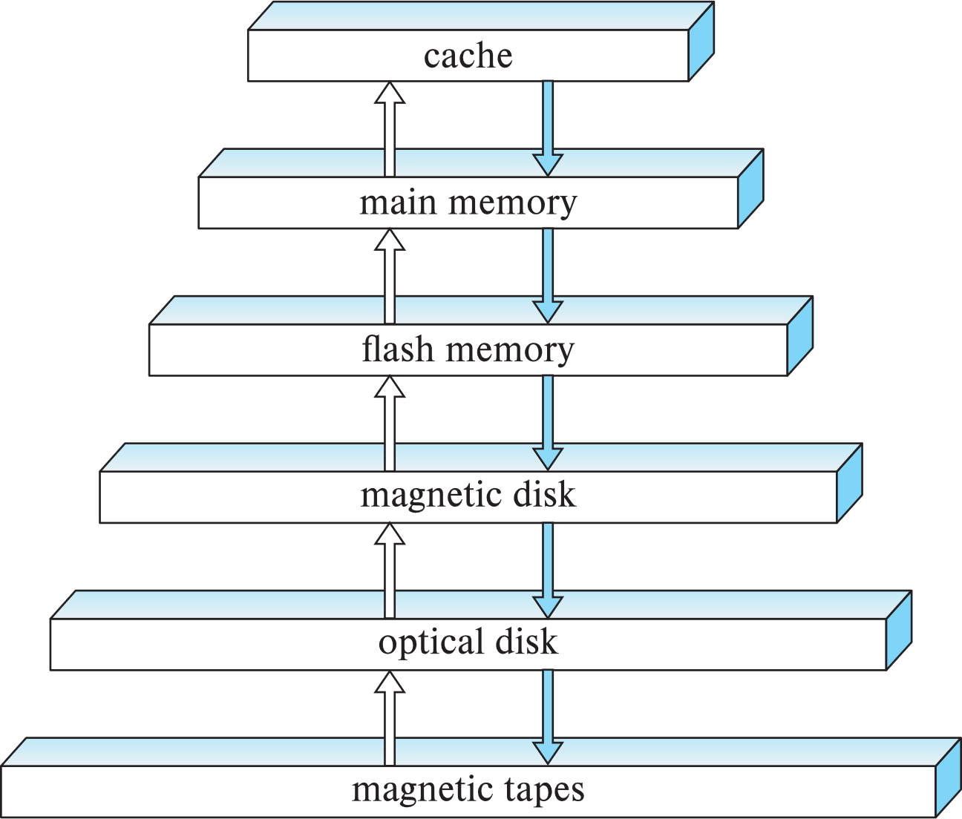
Storage Hierarchy
Question- 1
Identify-
primary storage,
secondary storage and
tertiary storage.

Slide 13
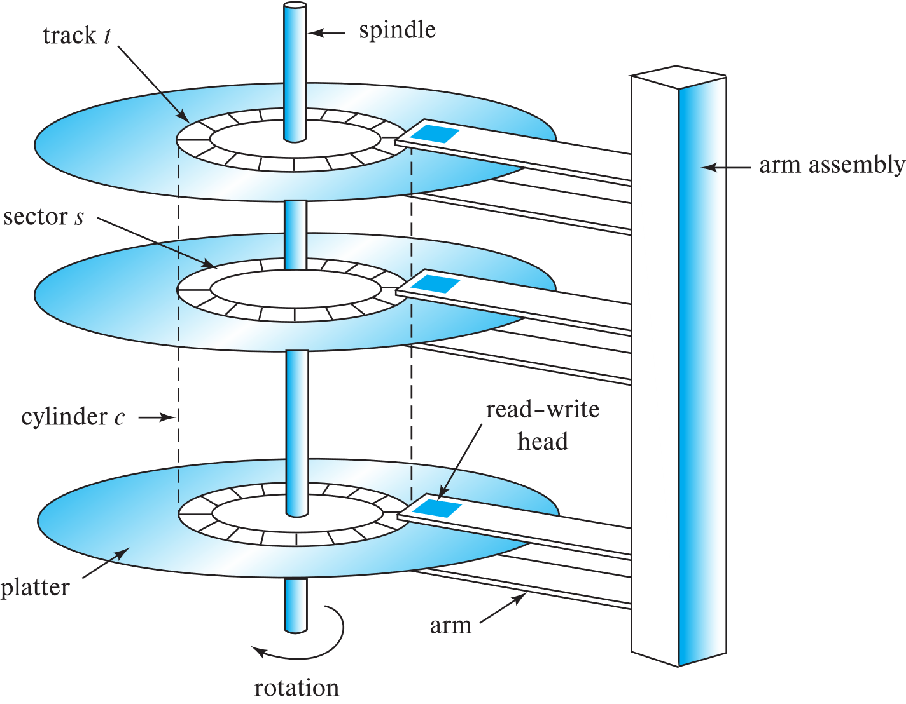

Magnetic Hard Disk Mechanism
Schematic diagram of magnetic disk drive
Photo of magnetic disk drive

Slide 14
Magnetic Disks
Read-write head
Surface of platter divided into circular tracks
  Over 50K-100K tracks per platter on typical hard disks
Each track is divided into sectors.
  A sector is the smallest unit of data that can be read or written.
  Sector size typically 512 bytes
  Typical sectors per track: 500 to 1000 (on inner tracks) to 1000 to 2000 (on outer tracks)
To read/write a sector
  disk arm swings to position head on right track
  platter spins continually; data is read/written as sector passes under head
Head-disk assemblies
  multiple disk platters on a single spindle (1 to 5 usually)
  one head per platter, mounted on a common arm.
Cylinder i consists of i^{th} track of all the platters
Notes:
Mention: checksums, bad sector remapping

Slide 15
Performance Measures of Disks
Access time – the time it takes from when a read or write request is issued to when data transfer begins. Consists of:
  Seek time – time it takes to reposition the arm over the correct track.
    4 to 10 milliseconds on typical disks
  Rotational latency – time it takes for the sector to be accessed to appear under the head.
    4 to 11 milliseconds on typical disks (5400 to 15000 r.p.m.)
  Overall latency is 5 to 20 msec depending on disk model
Data-transfer rate – the rate at which data can be retrieved from or stored to the disk.
  25 to 200 MB per second max rate, lower for inner tracks

Slide 16
Magnetic Hard Disk Mechanism
Student relation is stored at innermost track of top plater and starting location is in sector 128 (256 sectors in each track) and head position in outer most track.
The query is:
Select *
From student
Question 2:
Explain the disk arm movement to execute the above query?
Find access time. Seek time is 10ms and rotational latency is 10ms.
Schematic diagram of magnetic disk drive

Slide 17
RAID
RAID: Redundant Arrays of Independent Disks
  disk organization techniques that manage a large numbers of disks, providing a view of a single disk of
    high capacity and high speed by using multiple disks in parallel,
    high reliability by storing data redundantly, so that data can be recovered even if a disk fails

Slide 18
Improvement in Performance via Parallelism
Two main goals of parallelism in a disk system:
Load balance multiple small accesses to increase throughput
Parallelize large accesses to reduce response time.
Improve transfer rate by striping data across multiple disks.
Bit-level striping – split the bits of each byte across multiple disks. In an array of eight disks, write bit i of each byte to disk i.
Each access can read data at eight times the rate of a single disk (sequential access).
  Example: select * from student;
But seek/access time worse than for a single disk. (Find i^{th} Byte?)
  Example: Select * from student where id = 05050
Bit level striping is not used much any more
Student relation
101011110000000011111111…
Storing 1st byte
1
0
1
0
1
1
1
1
Storing 2nd byte
10
00
10
00
10
10
10
10

Slide 19
Improvement in Performance via Parallelism
Student relation
B0, B1, B2, B3, B4, B5, B6, B7, B8, B9, B10, B11, B12, B13
Block-level striping – with n disks, block i of a file goes to disk (i mod n) + 1
1. Requests for different blocks can run in parallel if the blocks reside on different disks
  Example: Example: Select * from student where id >= 05005
2. A request for a long sequence of blocks can utilize all disks in parallel
Example: select * from student;
Block-level striping with 8 disks
B0
B1
B0
B3
B4
B5
B6
B7
After Block 7
B0
B8
B1
B9
B2
B10
B3
B11
B4
B12
B5
B13
B6
B7
Discussion: Explain points 1 and 2 of block level striping

Slide 20
RAID Levels
RAID Level 0
Example: You need 8TB of storage and there are available of 2TB disks.
How many disks will be needed for this storage system in RAID 0?
Different RAID organizations, or RAID levels, have differing cost, performance and reliability characteristics
RAID Level 0: Block striping; non-redundant.
Used in high-performance applications where data loss is not critical.
D0 D1 D2 D3
You have to store student relation file (B0, B1, B2, B3, B4, B6, B7, B8, B9) into the storage system of RAID 0.
How?
D0 D1 D2 D3
B0
B4
B8
B1
B5
B9
B2
B6
B3
B7

Slide 21
RAID Levels
RAID Level 1 (Mirroring)
RAID Level 1: Mirrored disks with block striping
Offers best write performance.
Popular for applications such as storing log files in a database system.
Example: You need 8TB of storage and there are available of 2TB disks.
How many disks will be needed for this storage system in RAID 1?
D0 D1 D2 D3
D4 D5 D6 D7
DATA
MIRROR DISK
Question: You have been given 6 disks of 4TB each and customer relation has 6 blocks (B0, B1, B2, B3, B4, B5).
Show the storage of customer relation using
RAID level 0 storage system
RAID level 1 storage system
You have to store student relation file (B0, B1, B2, B3, B4, B5, B6, B7, B8, B9) into the storage system of RAID 1.
How?
D0 D1 D2 D3
B0
B4
B8
B1
B5
B9
B2
B6
B3
B7
D4 D5 D6 D7
B0
B4
B8
B1
B5
B9
B2
B6
B3
B7

Slide 22
RAID Levels (Cont.)
RAID Level 5 (Block striping distributed parity)
Example: You need 8TB of storage and there are available of 2TB disks.
How many disks will be needed for this storage system in RAID 5?
RAID Level 5: Block-Interleaved Distributed Parity;
partitions data and parity among all N + 1 disks, rather than storing data in N disks and parity in 1 disk (like RAID 4).
E.g., with 5 disks, parity block Pk for blocks 4k, 4k+1, 4k+2, 4k+3 is stored in disk k mod 5.
P0
B4
B8
D0 D1 D2 D3 D4
B0
P1
B9
B1
B5
B2
B6
B3
B7

Slide 23
RAID Levels (Cont.)
RAID Level 5 (Block striping distributed parity)
Parity blocks: Parity block j stores XOR of bits from block j of each disk
How is recovery performed single disk failure?
To recover data for a block, compute XOR of bits from all other blocks in the set including the parity block
What will happen if two disks failed simultaneously?
Example: You need 8TB of storage and there are available of 2TB disks.
How many disks will be needed for this storage system in RAID 5?
P0
B4
B8
D0 D1 D2 D3 D4
B0
P1
B9
B1
B5
B2
B6
B3
B7

Slide 24
RAID Levels (Cont.)
RAID Level 5 (Block striping distributed parity)
How is update of one block performed in RAID 5?
Example: Updating block B2 of D2, parity block P0 must also be computed and written to disk
Can be done by using old parity block, old value of current block (B2) and new value of current block (B2) (2 block reads + 2 block writes)
Or by recomputing the parity value using the new values of blocks corresponding to the parity block. More efficient for writing large amounts of data sequentially
Example: You need 8TB of storage and there are available of 2TB disks.
How many disks will be needed for this storage system in RAID 5?
P0
B4
B8
D0 D1 D2 D3 D4
B0
P1
B9
B1
B5
B2
B6
B3
B7
Question: You have been given six disks of 8TB each.
What are the effective storage capacity in RAID 0, RAID 1, RAID 5?
Given blocks B1, B2 …..B10. Show the storage of these blocks in RAID 5 for six disks.

Slide 25
Indexing

Slide 26
Basic Concepts
Indexing mechanisms used to speed up access to desired data.
  E.g., author catalog in library
Search Key - attribute or set of attributes used to look up records in a file.
An index file consists of records (called index entries) of the form
Index files are typically much smaller than the original file
Two basic kinds of indices:
  Ordered indices: search keys are stored in sorted order
  Hash indices: search keys are distributed uniformly across “buckets” using a “hash function”.
search-key
pointer

Slide 27
Index Evaluation Metrics
Access types supported efficiently. E.g.,
  records with a specified value in the attribute
  or records with an attribute value falling in a specified range of values.
Access time
Insertion time
Deletion time
Space overhead

Slide 28
Ordered Indices
In an ordered index, index entries are stored sorted on the search key value. E.g., author catalog in library.
Primary index: in a sequentially ordered file, the index whose search key specifies the sequential order of the file.
  Also called clustering index
  The search key of a primary index is usually but not necessarily the primary key.
Secondary index: an index whose search key specifies an order different from the sequential order of the file. Also called
non-clustering index.
Index-sequential file: ordered sequential file with a primary index.

Slide 29

Dense Index Files
Dense index — Index record appears for every search-key value in the file.
E.g. index on ID attribute of instructor relation

Slide 30

Dense Index Files (Cont.)
Dense index on dept_name, with instructor file sorted on dept_name

Slide 31

Sparse Index Files
Sparse Index: contains index records for only some search-key values.
  Applicable when records are sequentially ordered on search-key
To locate a record with search-key value K we:
  Find index record with largest search-key value < K
  Search file sequentially starting at the record to which the index record points

Slide 32

Secondary Indices Example
Secondary index on salary field of instructor
Index record points to a bucket that contains pointers to all the actual records with that particular search-key value.
Secondary indices have to be dense

Slide 33
Primary and Secondary Indices
Indices offer substantial benefits when searching for records.
BUT: Updating indices imposes overhead on database modification --when a file is modified, every index on the file must be updated,
Sequential scan using primary index is efficient, but a sequential scan using a secondary index is expensive
  Each record access may fetch a new block from disk
  Block fetch requires about 5 to 10 milliseconds, versus about 100 nanoseconds for memory access

Slide 34
B⁺-Tree Index Files
B⁺-tree indices are an alternative to indexed-sequential files.
Disadvantage of indexed-sequential files
  performance degrades as file grows, since many overflow blocks get created.
  Periodic reorganization of entire file is required.
Advantage of B⁺-tree index files:
  automatically reorganizes itself with small, local, changes, in the face of insertions and deletions.
  Reorganization of entire file is not required to maintain performance.
(Minor) disadvantage of B⁺-trees:
  extra insertion and deletion overhead, space overhead.
Advantages of B⁺-trees outweigh disadvantages
  B⁺-trees are used extensively

Slide 35

Example of B⁺-Tree

Slide 36
Example of B⁺-Tree
Question:
Given B+ tree index on ‘name’ attribute.
What is the type of index?
Primary/secondary, explain.
How many primary can be created for a relation?
How many secondary index can be created for this relation?
Id | Name | Dept. | Salary

Slide 37
Example of B⁺-Tree
Question:
Given B+ tree index on name attribute. How the following query will be executed?
Select *
From instructor
Where name = ‘Gold’
Id | Name | Dept. | Salary

Slide 38
Example of B⁺-Tree
Question:
How the following query will be executed?
Select *
From instructor
Where Id = 83821
Id | Name | Dept. | Salary

